Slide 1
Theme of Love (and Lust)
- Othello

Slide 2
Introduction
There are many different types of ‘love’ in the world; and many different kinds of relationships.
In Othello we are exposed to many of these kinds of variations.
Some are quite positive and admirable; while others are both negative and disturbing.
No relationship is exclusive to one ‘label’.

Slide 3
Love
Culture
Possession
Abuse
True Love
Lust
Social advance
Peculiar notions…

Slide 4
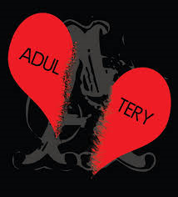
In Venice; love is cheap…
Over the course of the entire play; we get a very sordid and promiscuous view of love in the city of Venice. It seems infidelity is rampant
This chiefly derives from the sordid descriptions that the cynical Iago provides both Roderigo and Othello with:
‘I know our country disposition well: In Venice they do let God see their pranks they dare not show their husbands’.

Slide 5
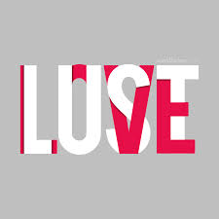
‘Their best conscience is not to leave't undone, but keep't unknown’. (Venetian Women)
‘It is a creature that dotes on Cassio; as 'tis the strumpet's plague to beguile many and be beguiled by one’. (Bianca)
Iago confides to Roderigo that Desdemona is a ‘typical Venetian’:
‘Nature will instruct her in it and compel her to some second choice’.

Slide 6
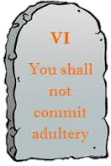
The Villain has even convinced himself that his wife has betrayed him with both Othello AND Cassio!
‘I do suspect the lusty Moor hath leap’d into my seat’.
‘I do fear Cassio with my night-cap too’.

Slide 7
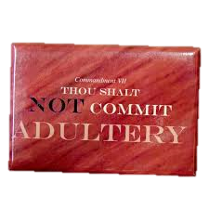
Even Emelia conjures up a world where infidelity is rampant:
‘Yet have we some revenge. Let husbands know their wives have sense like them: they see and smell and have their palates both for sweet and sour, as husbands have’.
This also helps to conjure up a sickly atmosphere for the play…the whole world is disloyal and sordid!!

Slide 8
Love as a possession
The very first example of a ‘loving relationship’ we are exposed to in Othello is the relationship of Brabantio and Desdemona.
The Senator claims to be a loving father but he speaks of her as though she is his possession. He firmly denounces all of Roderigo’s advances:
‘My daughter is not for thee!’

Slide 9
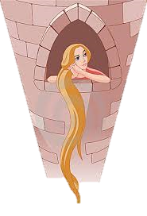
We see this possessive behaviour in a much more obvious light as he exclaims his shock that Desdemona ‘escapes’:
‘O heaven, how got she out?!’
Brabantio speaks here as though Desdemona were an animal that was locked in captivity. This is not a typical ‘loving’ relationship.

Slide 10
This relationship reaches the pinnacle of possessive behaviour when Brabantio charges Desdemona to choose between him and her new husband. He asks:
‘Where most you owe obedience?’
Upon her (logical) choice of Othello; Brabantio disowns his daughter:
‘God bu’y, I ha’ done. I had rather adopt a child than get it’.
Brabantio’s love for Desdemona is quite conditional. Not only does he keep her ‘locked up’, but he is unwilling to share her with ANY man!!

Slide 11
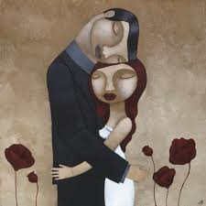
True Love
However, we are also given a strong and admirable show of true love in the guise of the relationship of Othello and Desdemona.
To begin with, the couple have exceptionally affectionate pet names for one another:
‘honey’, ‘O my sweet’, and ‘O my fair warrior’.
(Othello ↑)
‘My dear Othello!’ (Desdemona)

Slide 12
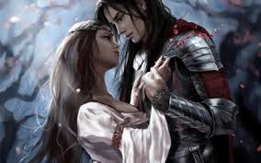
Othello trusts his wife so much that he places his life in her hands:
‘Let her speak of me before her father . If you do find me foul in her report …let your sentence even fall upon my life’.
This couple cannot bear to be away from one another:
‘I did love the Moor to live with him’. (goes to war with him)

Slide 13
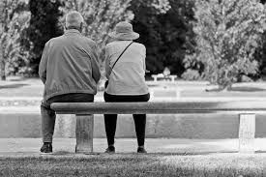
What is even more revealing is that this couple fully believe that they are as happy as they could ever be. They see their future as a combined one:
‘Heaven forbid but that our loves and comforts should increase, even as our days do grow’. (Desdemona)
‘If I were to die, ‘twere now to be most happy’. (Othello)
This would seem to be the perfect example of the truest and purest of loves….BUT….

Slide 14
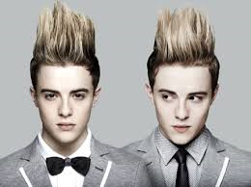
Peculiar foundations…Love or awe?
One question that MUST be asked of this couple is whether they are really in love? There relationship seems to have some very questionable foundations.
Desdemona seems to have fallen for this ‘exotic’ stranger. She would
‘With a greedy ear devour up my discourse’.
As we all know; the novelty factor will eventually wear off. Any real relationship MUST have more.

Slide 15
Similarly, Othello seems to have liked the attention and pity that he received. It is as though he wants to be mothered!!
‘She loved me for the dangers I had pass’d, and I loved her that she did pity them’.
This is a very flimsy basis for ‘love’. Novelty will always wear off. True love requires a deeper spiritual connection.
You can equally discuss this under the heading of ‘forbidden love’.

Slide 16
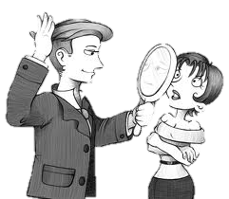
What also should be highlighted is Othello’s bizarre and vain protests against Desdemona’s seeming infidelity.
SHARING HER does bother him; but it is his reputation and troubled mind that affects him most. We see this when he roars:
‘Cuckold me? I will chop her into messes!’
It would seem that he is more affected that ANYONE would dare make him look stupid. His image concerns him more!!

Slide 17
‘He that is robb’d, not wanting what is stol’n, let him not know’t and he’s not robbed at all’.
‘I had been happy if the general camp, pioners and all, had tasted her sweet body, so I had nothing known’. (Ignorance is bliss)
This is a very poor sign as he is more concerned with his peace of mind that the fact that he is in a broken marriage.
It is no great wonder that Iago easily plies them apart.

Slide 18
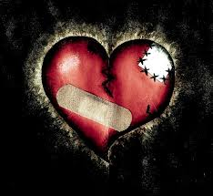
Abusive Love
It is said that it is the people closest to us that we hurt the most. This is very true in the case of Iago and Emelia (although it is debatable whether they are close in any capacity!).
In Iago’s case; he has nothing but abuse and insults for his wife:

Slide 19
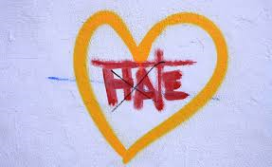
‘A thing for me? It is a common thing… to have a foolish wife’.
‘How now, what do you here alone?’
While it is meant in jest, Iago continues to poke insult at Emelia; even when the poor woman is minding her own business:
‘You rise to play, and go to bed to work’.

Slide 20
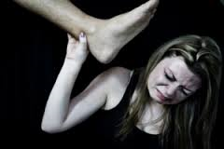
The most obvious abuse of all in this relationship is the fact that he threatens her and eventually STABS HER!!!!
‘Go to, charm your tongue!’
‘I charge you get you home!’
‘Zounds’, hold your peace’.
‘Villainous whore!’.
It is this abuse that we view Iago as despicable. Any audience with a shred of decency will view this behaviour for the horror it is.

Slide 21
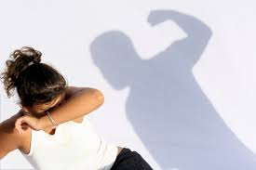
The relationship of Othello and Desdemona also has elements of abuse; especially as Iago’s net begins to tighten:
‘I will chop her into messes’.
[striking her] ‘Devil!’.
‘O devil, devil! If that the earth could teem with woman’s tears, each drop she falls would prove a crocodile. Out of my sight!’.
‘Out Strumpet!’

Slide 22
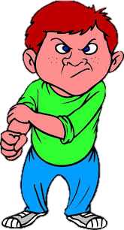
Although not as prevalent or extreme, we see the ‘noble’ and gentlemanly Cassio treat Bianca with much disrespect as he insults her and berates her with cruel names:
‘Go to, woman! Throw your vile guesses in the devil’s teeth from whence you have them’.
In the world of this play; there is more abusive love than true love.

Slide 23
Lust
Physical attraction Physical attraction
+ mental attraction - mental attraction
= True Love = Lust
We see a lot of lust in the world of Othello. It is a poor substitution for true love; but many characters are willing to settle for it.
To begin with, what we do not see in the ‘relationship’ of Roderigo and Desdemona is more revealing. …

Slide 24
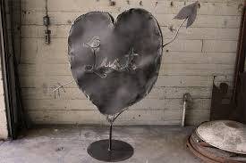
WE NEVER EVEN SEE THEM CONVERSING…nor does Desdemona reference him ONCE!! Does she even know he exists?
Having said that, Roderigo is besotted by her and cannot live without her, and will sacrifice all for her:
‘I will incontinently drown myself’.
‘My daughter is not for thee’.

Slide 25
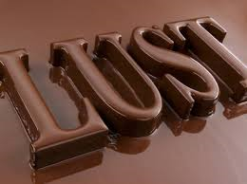
Similarly, Iago makes a strong case to the gullible young Venetian that Desdemona only lusts after Othello:
‘It is merely a lust of the blood and a permission of the will’.
‘When the blood is made dull with the act of sport’.
‘When she is sated with his body, she will find the error of her choice’.
Roderigo does not have any belief in true love as he is chasing a woman that has no interest in him; and he succumbs to this excuse of lust far too easily!!

Slide 26
The relationship of Cassio and Bianca is another one based solely on lust. The most prominent example is the fact that Cassio does not respect this courtesan at all:
‘Tis such another fitchew. Marry, a perfumed one’.
‘Poor caitiff’. ‘This is the monkey’s own giving out’.
‘I marry her?...bear some charity to my wit!’
Despite the fact he speaks of her in a crude manner…he still intends to ‘sup there’.

Slide 27
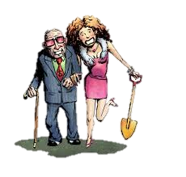
Love as a means of Social Advancement
Why would Bianca attach her to a man who neither respects her nor treats her well?
Bianca’s correct role is a courtesan; she is a social climber and will happily attach herself to such a man as Cassio in the hope that she will become a ‘lady’.
‘An you’ll come to supper tonight?’

Slide 28
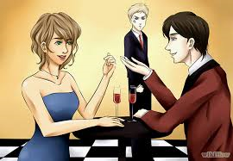
Does Iago love Othello?
There is considerable argument to be made for the notion that Iago is homosexual and Othello’s rejection is too difficult to take.
This would certainly explain the pleasure he takes in destroying Cassio and Desdemona:
‘As little a web as this will ensnare as great a fly as Cassio’.

Slide 29
His homosexual tendencies can be acknowledged by his VERY graphic portrayal of the night he spent with Cassio:
‘And then, sir, would he gripe and wring my hand, Cry 'O sweet creature!' and then kiss me hard, As if he pluck'd up kisses by the roots That grew upon my lips: then laid his leg Over my thigh, and sigh'd, and kiss'd; and then Cried 'Cursed fate that gave thee to the Moor!’
Not only is this very homoerotic…but could it be that this is Iago’s dream, and it is a cursed fate that gave both Cassio and Desdemona ‘to the Moor’?

Slide 30
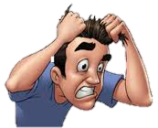
Repressing his homosexuality would also explain his bizarre hatred of women:
‘You rise to play, and go to bed to work’.
‘To suckle fools and chronicle small beer’.
If indeed he is gay; being forced to live a lie as a married man might explain such venom.

Slide 31
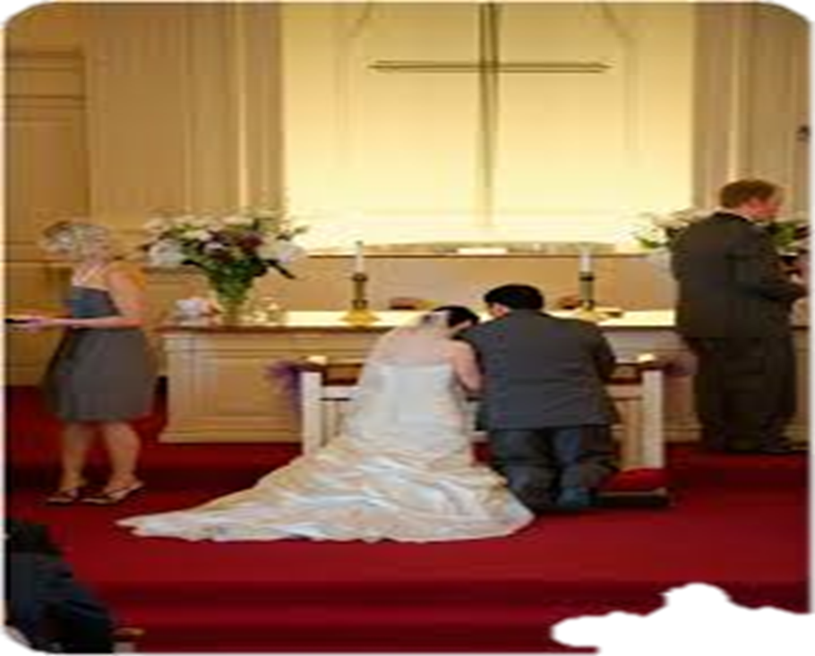
Shakespeare hints at this also at the end of the ‘Temptation Scene’.
We see Iago take Othello’s hand, pray with him and vow fidelity to him.
This is a mirror image of a marriage scene!! Iago finishes this scene with the promise that:
‘I am your own for ever’.

