Slide 1
The Theme(s) of Deception (Hypocrisy, Betrayal + False appearances)
- Othello

Slide 2
The Theme
The theme of deception is the most prevalent and obvious theme of the entire play.
The whole plot revolves around Iago’s deception of many characters.

Slide 3
What to discuss.
This theme will offer a wide range of discussion topics:
Characters (those who deceive & are deceived)
Relationships that are based on deception.
Symbols of deception.
The progression of the plot.
The atmosphere within the play.
Entertainment

Slide 4
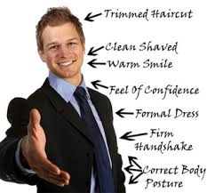
The opening scene
The opening scene abounds in deception (Mainly on the part of Iago!!)
Within a few moments we learn that nothing is as it seems in Venice:
First impressions ALWAYS count.

Slide 5
‘I follow him to serve upon my turn’.
‘who, trimm’d in forms and visages of duty, keep yet their hearts attending on themselves, and throwing but shows of service on their lords…these fellow have some soul’.
‘In following him, I follow but myself’.
‘ Sir, you are robbed!’.
‘I must show out a flag and sign of love!’
‘O she deceives me’. (Brabantio)
This is strategic on the part of Shakespeare: This immediately creates an atmosphere of mystery and treachery where very little is as it seems to be.
This sets the tone for the play to come!!

Slide 6
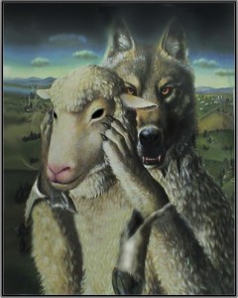
Iago
Iago is an exceptionally deceitful
character.
‘When devils will their blackest sins put on, they do suggest at first with heavenly shows, as I do now’.
This quote alone acts a powerful insight into the character of Iago.

Slide 7
What is more is that Iago swears to the two-faced God Janus
‘By Janus, I think no’.
This is reinforced as
he describes those he admires
‘who, trimm’d in forms
and visages of duty,
and throwing but shows of service on their lords…these fellow have some soul’.
( ‘and such a one I do profess myself’ )
This symbol speaks volumes. His deities are those who deceive.
Similarly, Iago has utter respect for those who put on false shows of loyalty for personal gain. ( + he admits his duplicity!!!)

Slide 8
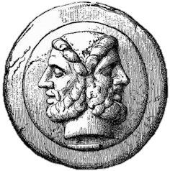
Atmosphere
Shakespeare NEEDS to conjure up an atmosphere of treachery for a play that relies on it for the entire plot.
The reference to the two-faced ‘Janus’ creates such a treacherous and deceitful atmosphere.
This is reinforced with…

Slide 9
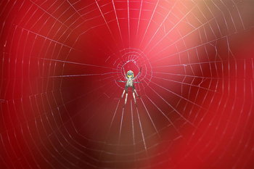
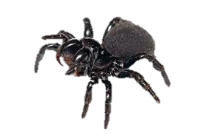
The Spider…
Spiders are synonymous with deception, trickery and traps. Iago comments that
‘with as little a web as this will I ensnare as great a fly as Cassio’.
An appropriately dark and deceptive atmosphere creeps into the play as a result.
What is more is that it acts as plot progression. Othello, Roderigo and Cassio will all voluntarily walk into their ‘friend’s’ trap and become STUCK!!!)

Slide 10
Iago and Roderigo
This is the first relationship that the audience witnesses. On the surface it looks to be a strong and cooperative one:
‘If thou canst cuckold him, thou doest thyself a pleasure, me a sport’.
In addition we get the impression that Iago is almost like a father to the young Venetian offering paternal advice on the issue of love:
‘No more of this drowning do you hear?’

Slide 11
However we learn quite swiftly that this is one of many relationships based on deception and hypocrisy as Iago announces smugly:
‘Thus do I ever make my fool my purse’.
(‘Put money in thy purse; follow these wars’)
He also derides the young man as:
‘This poor trash of Venice’.
This reaches its pinnacle when Iago eventually slays the poor lovesick fool:
‘O murderous slave! O villain!’

Slide 12
Iago and Othello
Obviously on the exterior this is a relationship where the subordinate Iago publically declares much love for his general:
‘I humbly do beseech you of your pardon, for too much loving you’.

Slide 13
However, this relationship is one of the most deceitful in the history of all literature. Iago points out how:
‘I follow him to serve my turn upon him’;
and that
‘Though I do hate him as hell’s pains…I must show out a flag and sign of love’.
Iago himself epitomises the deception in these two statements alone!
Iago plots the entire downfall of Othello…

Slide 14
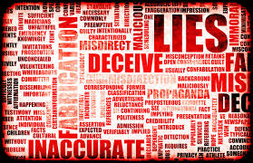
Desdemona’s ‘infidelity’:
‘She gave it to him, and he hath given it to his whore’.
Cassio’s ‘betrayal’:
‘In sleep I heard him say, “Sweet Desdemona, let us be wary, let us hide our loves”’.
The entire ‘affair’ is deception!:
‘A handkerchief – did I today see Cassio wipe his beard with’.

Slide 15
Iago and Cassio
As the play progresses we see that Iago becomes Cassio’s confidante and advisor in relation to his shredded relationship with the general.
Cassio speaks in a complimentary manner to Iago (‘You advise me well’ ) to which the latter responds:
‘I protest in the sincerity
of love and honest kindness’.
SEEMS like a strong and caring relationship… but…

Slide 16
He is disgusted at Cassio’s promotion of lieutenant:
‘One Michael Cassio, a Florentine…mere prattle without practise’.
We already know that Iago is plotting the downfall of his apparent friend:
‘As little a web as this will snare as great a fly as Cassio’.

Slide 17
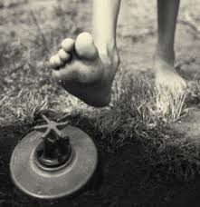
What is more is that he is the entire cause of Cassio’s downfall during the play:
‘Do you find some occasion to anger Cassio, wither by speaking too loud, or tainting his discipline…provoke him’.
[This leads to the Brawl Scene]

Slide 18
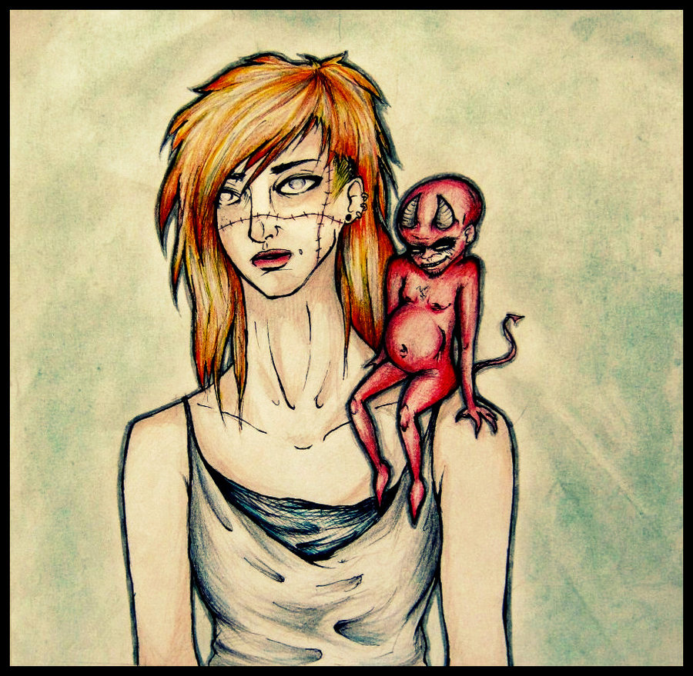
He betrays and deceives Cassio by giving him intentionally bad advice:
‘Our general’s wife is now the general…this brawl between you and her husband entreat her to splinter’.

Slide 19
Emelia
While Emelia is generally accepted as being wholly innocent of her husband’s wicked plot; she nonetheless becomes an accessory to it due to her role in the stealing of the handkerchief:
‘I am glad to have found this napkin…my wayward husband hath a hundred times woo’d me to steal it’.

Slide 20
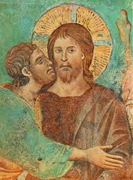
Emelia MUST share a portion of the guilt here as she deceives Desdemona for the sake of her ill-minded husband. When questioned on its whereabouts, she lies:
‘I know not, madam’.
This is also an act of betrayal as
Emelia knows that Desdemona ‘loves the token’.

Slide 21
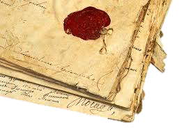
Roderigo
Roderigo is a character that is known for being gullible and is unfortunately on the receiving end of some of the most flagrant deception in the whole play.
However, we see at the climax of the play that this fool learns to adapt in this world of deception.
Roderigo plays a crucial role in the confirmation of Iago’s evil.

Slide 22
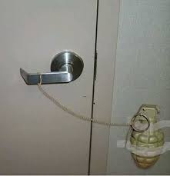
The letters that are found in Roderigo’s pocket prove Iago’s is as treacherous and wicked as Emelia declared:
‘Now here’s another discontented paper, found in his pocket too, and this, it seems, Roderigo meant to have sent this damned villain’.
One must ask WHY would anybody carry around such an incriminating document?
It would seem that Roderigo has come to recognise the world of deception and he himself deceives Iago!!
Roderigo has recognised Iago’s deception and used his own deception. He has devised a safety mechanism.

Slide 23
Desdemona
Desdemona is not innocent of deception in this play. Iago justifiably points out that:
‘She did deceive her father , marrying you’.
In addition, in her dying moments she also attempts to deceive the members of the court by claiming trying to exonerate Othello:
‘Nobody, I myself. Farewell’. BUT!

Slide 24
The major difference between Desdemona and all other characters is that she deceives for virtuous and positive reasons:
1) Love for Othello;
2) The hope that her beloved husband may escape punishment. (She even forgives him!!!
Why does she die?

Slide 25
Iago informs us that Desdemona:
‘She’s fram’d as fruitful as the free elements’.
Desdemona’s death serves as a symbolic representation of the actions of Iago; Innocence and purity drown in his sea of poisonous betrayal.
It also acts as a theatrical device; her death is the most tragic and underscores Iago as the villain.

Slide 26
Conclusion
Characters: Relationships:
Plot: Symbols:
Entertainment: Atmosphere:

