Slide 1
Othello

Slide 2
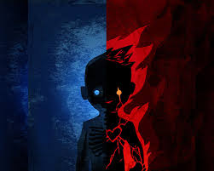
Dual sided character
When we meet Othello first he is an exceptionally impressive and noble character. He would appear to have everything going for him.
However, as the play progresses we see a very different character emerge and his nobility is slowly replaced with bitterness and suspicion.

Slide 3
Confident, calm and self-assured
Othello is self-assured and confident in the sense that he ignores ‘three great ones of the city’ and appoints Cassio to the role of lieutenant.
Iago also comments that he is ‘loving his own pride and purposes’.
His decision to elope with the daughter of his powerful friend smacks of an independent agent.

Slide 4
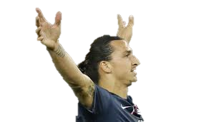
When faced with the threat of the angry Brabantio he calmly comments that the ‘services he has done the signiory, shall out-tongue his complaints’.
When looking upon the sword of Brabantio he calmly commands him to ‘keep up your bright swords, for the dew will rust ‘em’.
This can also be interpreted as ARROGANCE!

Slide 5
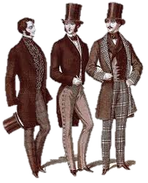
Well spoken & pays due respect.
It is important to point out that early in the play the character of Othello is very eloquent in his speech; and gentlemanly in his public behaviour.
‘Most potent, grave and reverend signiors, my very noble and approv’d good masters’.
‘Worthy Montano…the gravity and stillness of your youth the world hath noted’.

Slide 6
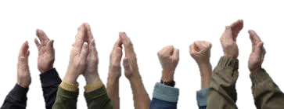
Well respected and admired
It should be commented that he is a well respected man and is spoken very highly of by both his peers and superiors.
‘Here comes Brabantio and The valiant Moor’.
Gentlemanly Montano also states that:
‘I have serv’d him and the man commands like a full soldier’.

Slide 7
Lodovico questions if:
‘this is the Noble Moor whom our full senate call in all sufficient’.
The Duke admits that
‘Your son-in-law is far more fair than black’.
Othello is certainly regarded as quite admirable at the beginning of the play.

Slide 8
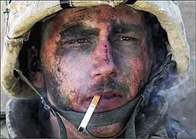
A good leader and brave soldier
Othello is certainly a brave and battle-hardened soldier as we hear of his exploits in previous encounters.
‘From year to year, the sieges, fortunes, that I have pass’d’.
‘The tyrant custom…hath made the flinty and steel couch of war my thrice-driven bed of down’.

Slide 9
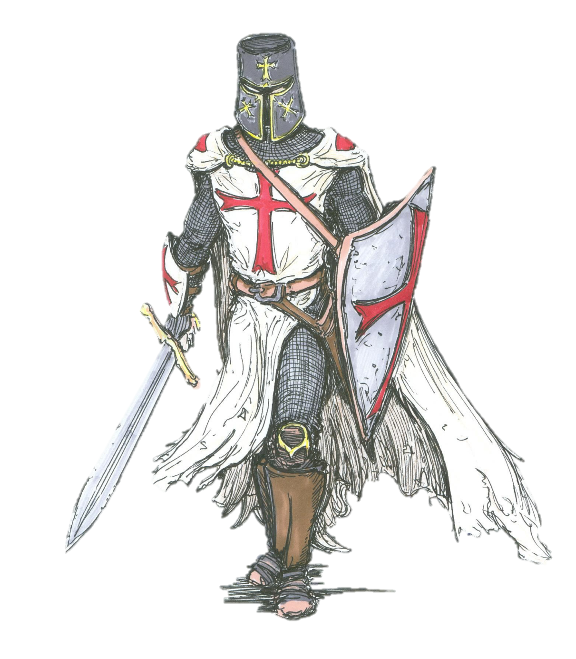
He is embraced by as a hero in Cyprus:
‘Thanks, you the valiant of this warlike isle that so approve the Moor’.

Slide 10
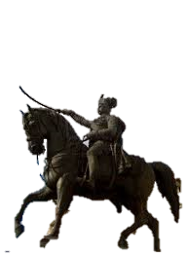
We also learn of his skill as a leader as he has an exceptional ability to command men. We see this on two occasions:
‘If I stir or do but lift this arm, the best of you shall sink in my rebuke’. (Battlements)
‘keep up your bright swords, for the dew will rust ‘em’. (Vs. Brababtio)

Slide 11
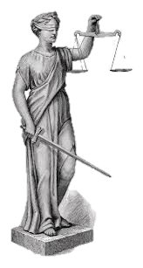
Justice
For better of worse; Othello always maintains an impartial sense of justice. He will sacrifice those closest to him in order to ensure justice prevails.
‘If I stir or do but lift this arm, the best of you shall sink in my rebuke’.
‘Cassio, I love thee, but never more be officer of mine’.
‘She must die, else she’ll betray more men’.

Slide 12

Confident in marriage/ Loves Wife
Othello has a lot of affection toward his Desdemona, referring to her as ‘honey’, ‘O my sweet’, and ‘O my fair warrior’.
He also claims that:
‘If I were to die, ‘twere now to be most happy’.

Slide 13
He places much faith in his wife as not only is he jeopardising his career by eloping with the daughter of a senator; and he trusts her with his life:
‘Let her speak of me before her father . If you do find me foul in her report …let your sentence even fall upon my life’.
(He puts his life in her hands)

Slide 14
Naïve & Innocent
We find out early on that Othello is ‘of a free and open nature that thinks men honest that but seem to be so and will as tenderly be led by the nose…As asses are’.
Iago is proven correct on many occasions as Othello cannot spot the villain that is before him:
‘Now art thou my lieutenant’.

Slide 15
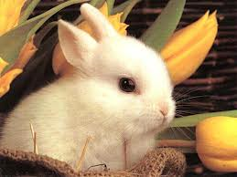
‘Honest Iago, that looks dead with grieving, Speak. Who began this?
This naivety will prove to be his fatal and tragic downfall (and perhaps his pride).

Slide 16
Gullible…Foolish?
Othello is certainly gullible as he falls for Iago’s deceit hook, line and sinker!
He openly falls for Iago’s reverse psychology when he dangles an ambiguously vague comment:
‘But for a satisfaction of my thought, no further harm’. (Iago)

Slide 17
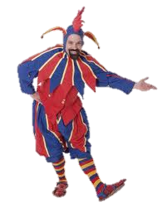
‘And didst contract and purse they brow together as if thou hadst shut up in thy brain some horrible conceit’.
Later on, he foolishly believes every false word that spills from Iago’s villainous lips:
‘She gave it him, and he hath given it his whore!’
‘But this denoted a foregone conclusion’.

Slide 18
Buckles under pressure?
We see another side to Othello that is quite peculiar for a man that is used to acting under pressure.
His fits of rage (and epilepsy) are possibly a consequence of being a successful military leader.
He is used to utter obedience; a clear chain of command.
Insubordination has never featured in his institutional life.

Slide 19
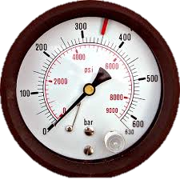
‘If thou dost slander her and torture me, never pray more!’ (throttles Iago)
‘My lord is fall’n into an epilepsy’.
He strikes Desdemona publically.
He kills her in a fit of rage without praying time.

Slide 20
It seems as though Othello is calm and collected when HE is in control.
He is quite aggressive and dangerous when things are beyond his grasp.
He does not possess the deceptive and sinister qualities that Iago is most famous for.

Slide 21
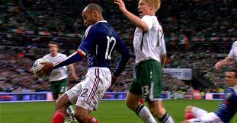
A hero with a tragic flaw
Therefore, we can safely acknowledge that while Othello is flawed; he is certainly a heroic man with a lot to be admired.
Had he not been targeted by Iago; he would almost certainly led a distinguished career and more than likely have had a happy marriage.

Slide 22
However…
As the play progresses; Othello is manipulated by the vindictive Iago and his devilish plot…

Slide 23

Falls to corruption
Othello slowly slips into a very similar character profile to Iago as his good nature is corrupted.
This begins quite innocently as he commissions Emilia to spy on Desdemona:
‘Set on thy wife to observe’.
However, we learn how easily he is deceived by his immediate question as to ‘Why did I marry?’

Slide 24
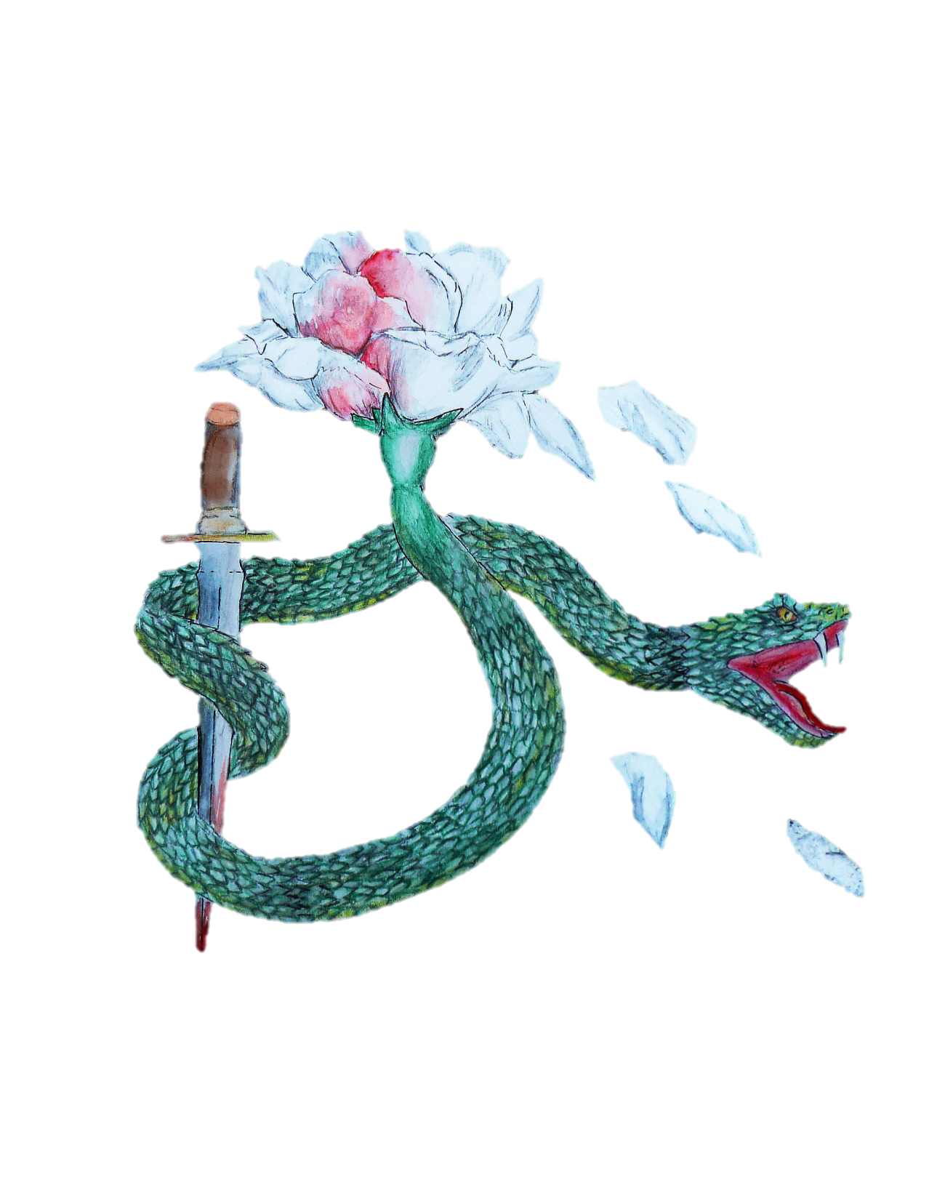
Instead of following discussing his doubts and fears with Desdemona; he proceeds to commission Iago to spy:
‘Villain, be sure thou prove my love a whore’.
He himself spies on the discussion between Iago and Cassio.
This is a man who has fallen from pride and confidence to suspicion and underhand tactics of deceit.

Slide 25
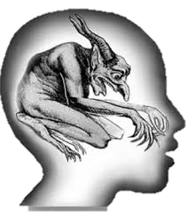
Corrupt/Perverse mind
Othello reminds the audience of Iago in relation to his perverse mind.
Just as Iago falsely believes Emilia had sexual encounters with both Othello and Cassio; Othello grafts his own sordid meanings onto Cassio’s gestures:
‘His gesture imports it’.
‘Now he tells how she pluck’d him to my chamber’.

Slide 26
Subterfuge and Crime
The nadir of Othello’s fall from a proud public hero to a common murderer is when he plots to commit double murder with Iago.
‘Within these three days, let me hear thee say that Cassio’s not alive’.
‘I will chop her into messes!’

Slide 27

Embraces the dark side
As our hero falls in our opinion; he commits to the dark side quite openly as he prays with Iago for evil to empower him to commit bloody revenge.
‘Arise, black vengeance, from thy hollow cell’.

Slide 28
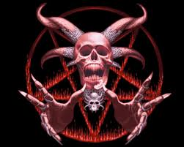
His previous mannerly demeanour and impeccable use of language is also rife with satanic references and symbolism:
‘It’s hypocrisy against the devil’
‘I will withdraw to furnish me with some swift means of death for the fair devil’.

Slide 29

Curses women. (Cynical)
Coinciding with his deception; treacherous tactics and satanic language; Othello also echoes Iago’s obvious hatred of women:
‘O curse of marriage that we can call these delicate creatures ours and not their appetites’.
‘She must die, else she’ll betray more men’.
‘If that the earth could teem with women’s tears, each drop she falls would prove a crocadile. Out of my sight!

Slide 30
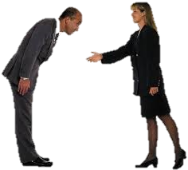
Distancing of relationship with Desdemona.
Obviously as the play continues; Iago scheme begins to bear fruit and there is distancing in the relationship with Desdemona.
This begins with the use of formal titles; and accusations:
‘Give me your hand. This hand is moist, my lady.’

Slide 31
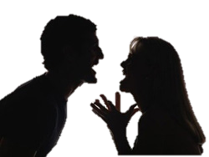
‘Out of my sight!’
‘Mistress!’
This culminates with Othello calling the pure Desdemona despicable names such as ‘Whore’, and ‘Strumpet’.
(He also insinuates Emilia is a pimp)

Slide 32
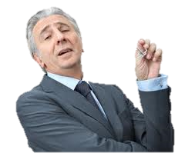
Pride is a factor
Othello’s reaction to Iago’s insinuations often smack of a real arrogance and distress that he will suffer a loss in reputation:
‘I will chop her into messes – cuckold me!
‘With mine officer!’
Similarly, in the final scene he asks to be remembered as an ‘honourable murderer’.

Slide 33


Torn between love and hate!
It must be acknowledged that right up to the final scene; Othello continuously speaks of both love, disdain and hate for Desdemona… usually in the same line!
He simply cannot decide how he feels:
‘If I do prove her haggard, though that her jesses were my dear heart-strings, I’Id whistle her off and let her down the wind to prayat fortune’.

Slide 34

We often see the general speak in contradictory terms:
‘A thousand, thousand times! And then of so gentle a condition!’
‘O thou black weed, why art thou so lovely fair?’
‘A balmy breath that dost almost persuade Justice herself to break her sword’.

Slide 35
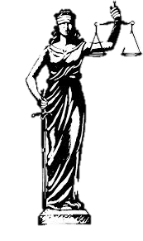
An agent of Justice
As is typical of human nature…Othello attempts to justify his decision to murder Desdemona. It is an act for all men. (Not personal at all!!):
‘She must die, else she’ll betray more men’.
Sadly…he allows himself to be commanded by his…

Slide 36
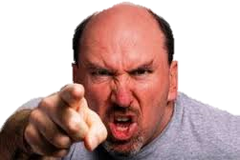
Temper…Cruel
For a man used to having orders obeyed; he is incapable of tolerating Desdemona’s persistent plea of innocence.
While Desdemona requests ‘but half an hour, but while I say one prayer’; Othello denies her this with rage. ‘Tis too late’.
To send her to what he believes is eternal damnation would have been utterly shocking for a Shakespearean audience!

Slide 37
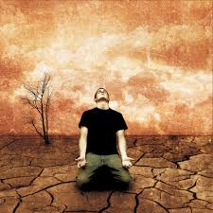
A noble final impression?
What is our final impression of Othello?
He does not attempt to disguise his role in the murder of Desdemona; nor the attempted murder of Cassio. He accepts his fate:
‘Nay, stare not, masters, it is true indeed.’
‘Why, anything; an honourable murderer, if you will, for nought did I in hate, but all in honour’.
This underscores the play as a tragedy.

Slide 38
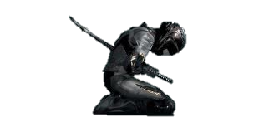
His fate? Self destruction
Othello dies knowing that he will burn in hell for his murder of Desdemona:
‘This look of thine will hurl my soul from heaven and fiends will snatch at it’.
Knowing this; he takes his own life without praying; thus committing himself to the death fate he believed Desdemona would face.

Slide 39
Villain or Victim?
While Othello is a villain; it must be acknowledged that he is abused as he is an outsider living within the civilised Venetian community.
Othello plays on his insecurities of him being:
- Racially different;
- Unfamiliar with Venetian customs;
- Venetian women’s notoriety promiscuity;

Slide 40
At the same time he never asked for any real hard evidence.
He foolishly and fickly settled for circumstantial and speculative evidence.
Villain or Victim?

